Slide 1
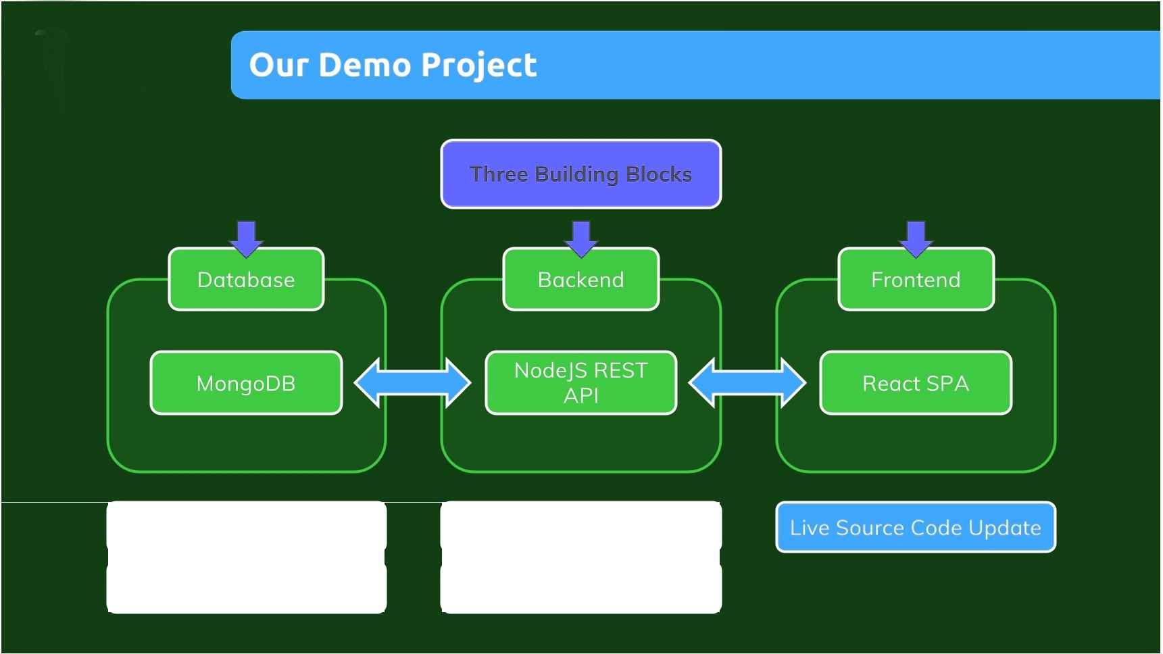
Data must persist
Data must persist
Access should be limited
I
Live Source Code Update

Slide 2
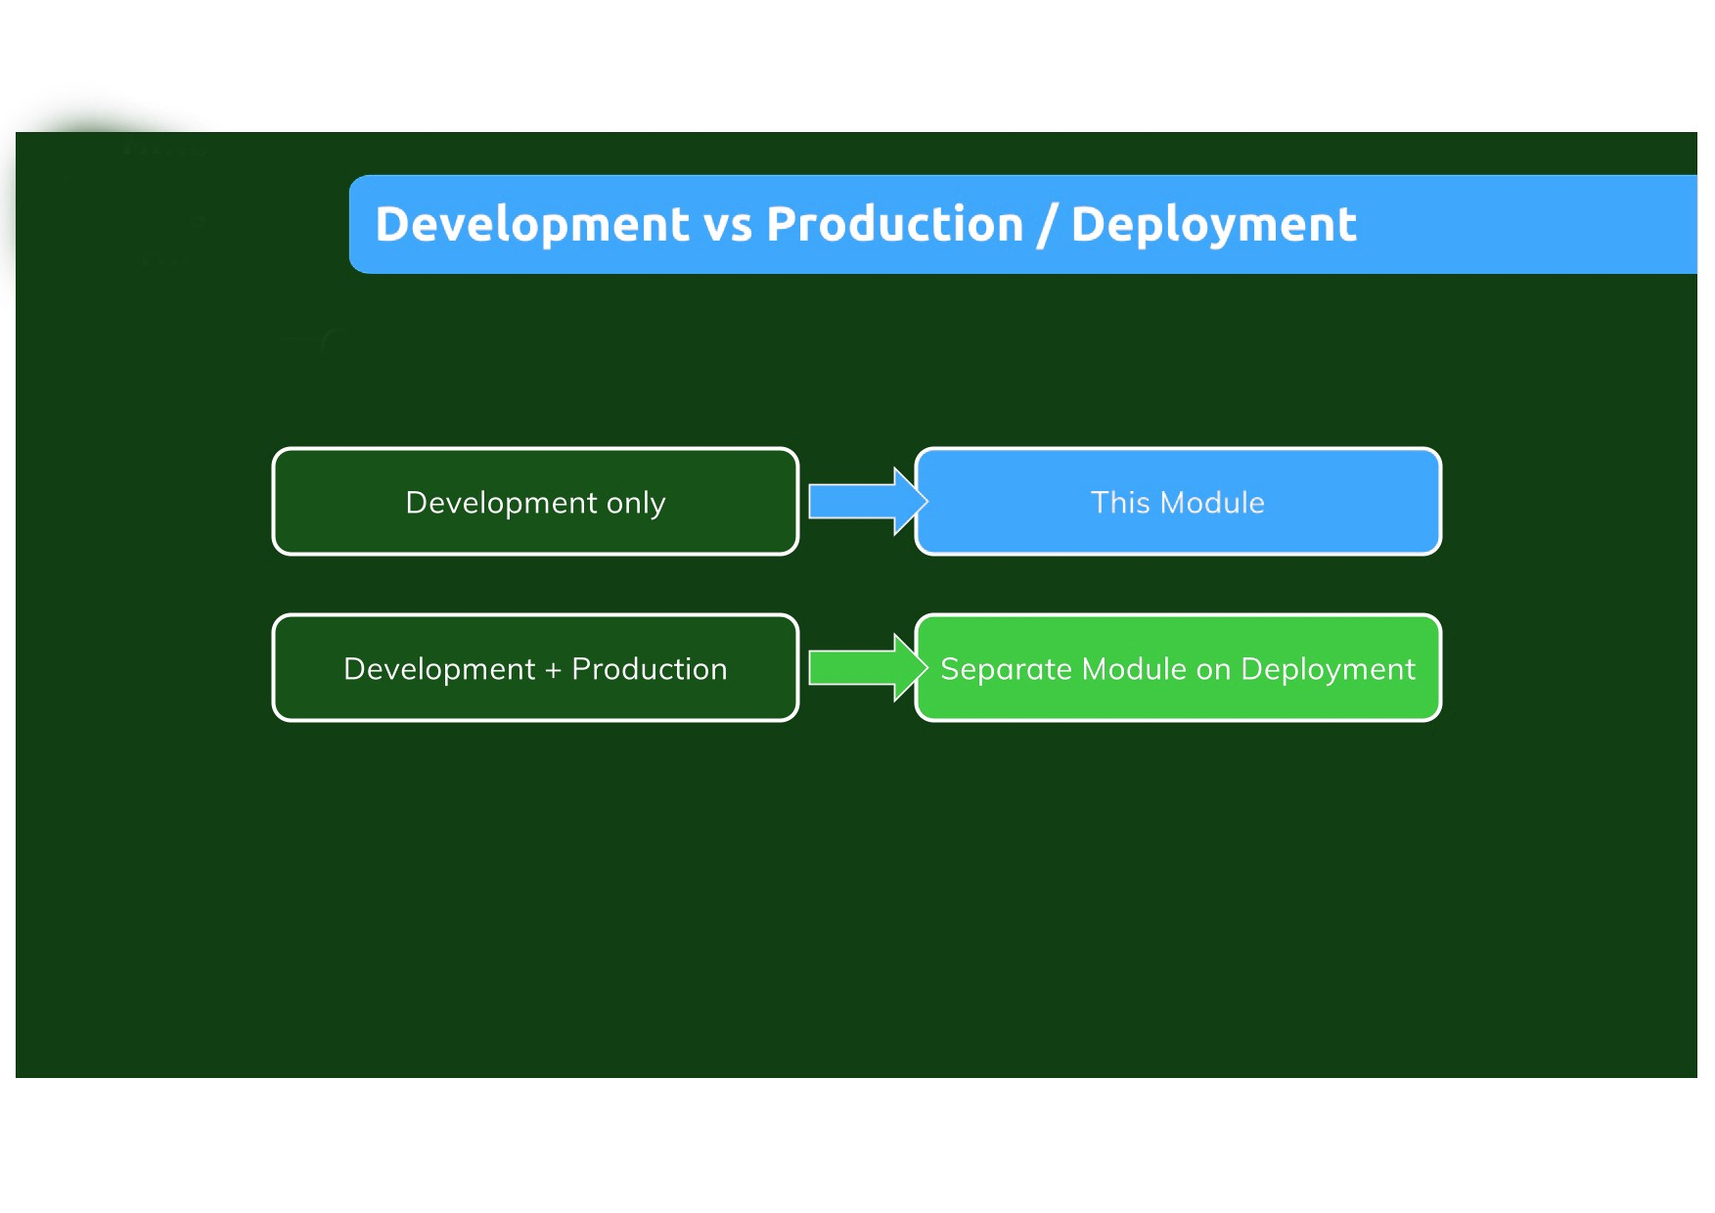

Slide 3
